Slide 1
Health & Wellness

Slide 2
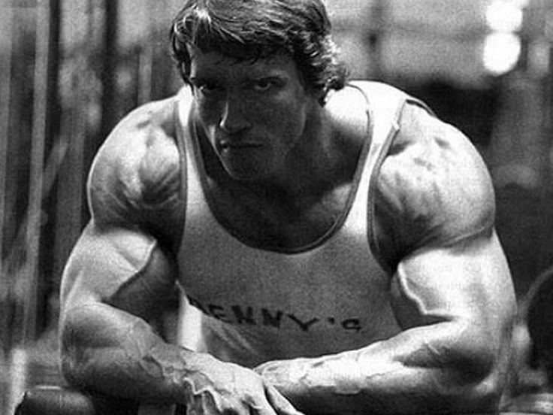
Bell Ringer
Name 5 people who you would describe as “ Healthy”.
For each person, describe why you think they are healthy

Slide 3
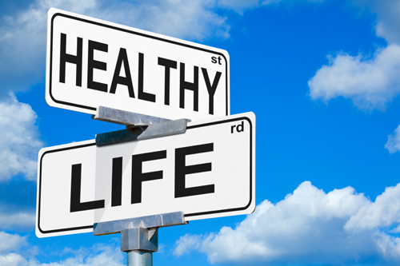
Health definition
Combination of physical, mental/ emotional, and social well – being
Sides of a triangle

Slide 4
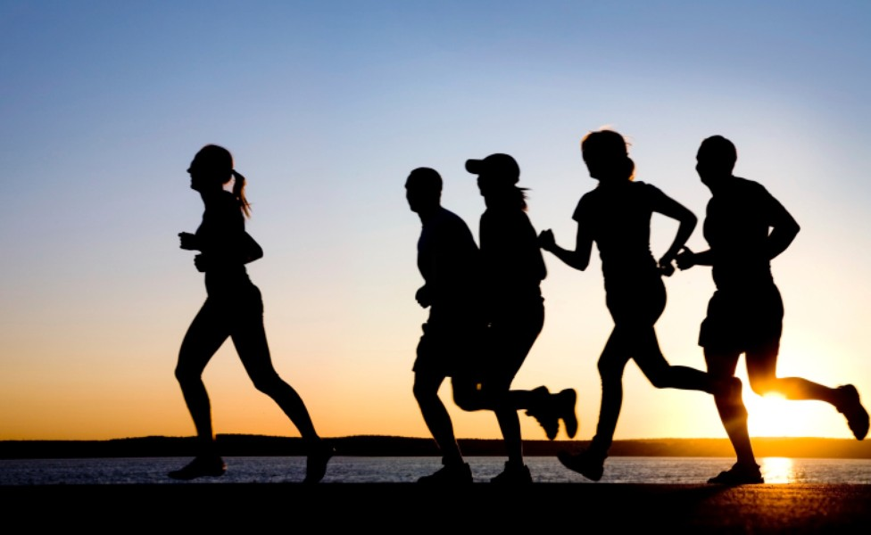
Physical health
Side 1 of Triangle
Describes the condition of your body

Slide 5
Mental/ emotional health
Side 2 of triangle
The way you recognize and deal with your feelings ; how you deal with life demands

Slide 6
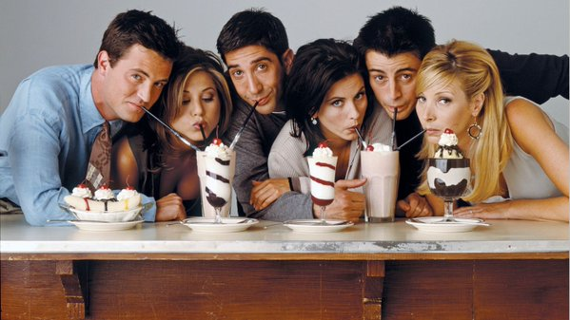
Social health
Side 3 of health triangle
Describes the way you interact with people

Slide 7
Your health triangle
Label your paper with each part of the triangle ( Physical, mental/ emotional, social )
For each statement write yes or no

Slide 8
Physical Triangle Statements
1. You get at least 8 hours of sleep each night
2. You eat a well balanced diet, including all of the food groups
3. You keep your body, teeth, & hair clean
4. you get at least 60 minutes of moderate to physical activity every day
5. You avoid using alcohol, tobacco, and other drugs
6. You see a doctor/ dentist for regular checkups

Slide 9
Mental/ emotional triangle statements
1. you feel good about yourself & accept who you are
2. You express your feelings clearly, even when you are upset or angry
3. You accept helpful criticism
4. You have at least one activity you enjoy
5. You feel like people like you and accept who you are
6. You like to new learn new things and develop new skills

Slide 10
Social Triangle statements
1. You have at least one close friend
2. You respect and care for your family / guardians
3. You can disagree with others without getting angry
4. You are a good listener
5. You get support from others when you need it
6. You say no when people ask you to do something that is wrong

Slide 11
Graphing Your health triangle
Add the number of “yes” answers for each area of health
Choose a symbol to represent your “ yes” answers such as a heart, circle etc.
Use the symbol to create a health triangle that shows your scores
Label each side of the triangle

Slide 12
Summarizing your health triangle
Are there areas of health in which you need to improve?
How can you improve these areas?
Are there areas of health in which you are really strong?
Do you have an equal sided triangle?

Slide 13
Bell ringer
What is the difference between health & wellness?

Slide 14
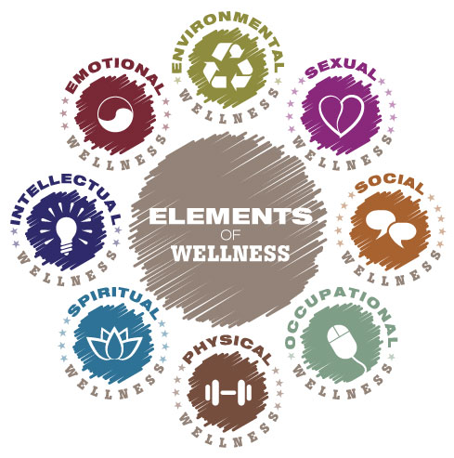
Achieving wellness
Wellness – state of well- being or balanced health over a long period of time

Slide 15
Mind- body connection
How your emotions affect your physical and overall health and how your overall health affects your emotions

Slide 16
Health assessment
A set of questions that allow you to evaluate your health

Slide 17
Assessing your health
Page 7
Answer the questions on a separate piece of paper
4 points – almost always
2 points – Sometimes
0 points – almost never

Slide 18
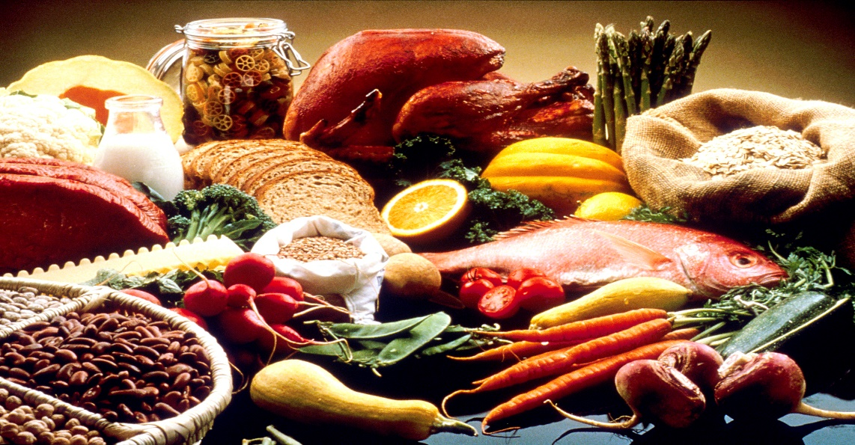
What are your favorite foods / activities ?

Slide 19
Heredity
Passing of traits from parents to their biological children
Examples?

Slide 20
Traits
Characteristics that a person has
Examples?

Slide 21
Environmental influences
All the living and nonliving things around you

Slide 22
Cultural background
Beliefs, customs, and traditions of a specific group of people

Slide 23
Media influence
Various methods for communicating information

Slide 24
Effects of commercials
https://www.youtube.com/watch?v=v76f6KPSJ2w

Slide 25
Bell ringer
Lifestyle -- behaviors and habits that help determine a person’s level of health.
Name 3 healthy lifestyle behaviors
Name 3 unhealthy lifestyle behaviors

Slide 26
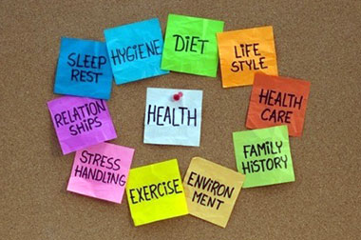
Lifestyle factors
Behaviors and habits that help determine a person’s level of health
Positive examples?
Negative examples?

Slide 27
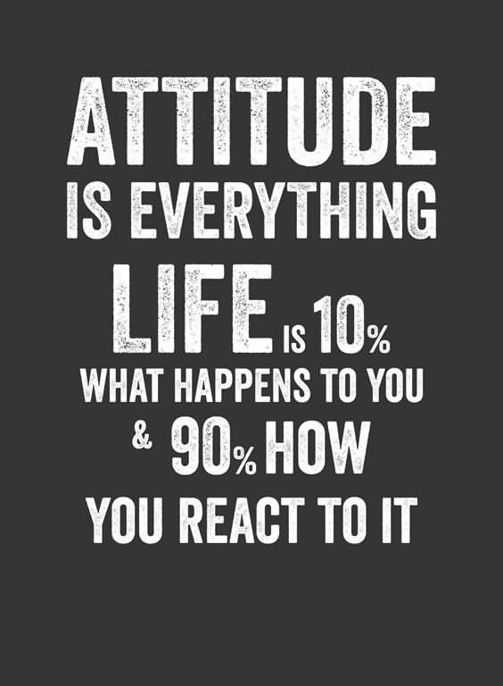
Attitude
Feelings or beliefs; the way you act, think, or feel that causes you to make one choice over another
Saying no
Confidence

Slide 28
The only disability in life is a bad attitude
https://www.youtube.com/watch?v=Wd89IydtXyk

Slide 29
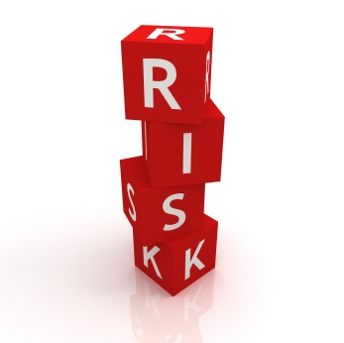
The chance that something harmful may happen to your health and wellness

Slide 30
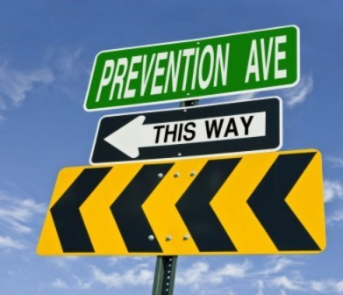
Preventative healthcare
Taking steps necessary to prevent illness or accidents

Slide 31
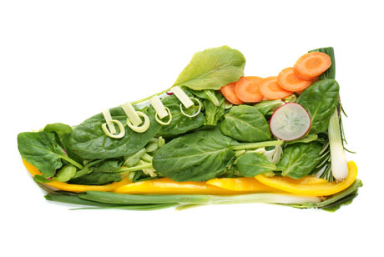
Proactive healthcare
Purposefully take action to improve your personal health before a problem arises

Slide 32
Abstinence
Conscious, active choice not to participate in high risk behaviors

Slide 33
Life skills ( health skills)
Skills that help you become and stay healthy
Improve you physical, mental/ emotional, and social health
Benefit you through life

Slide 34
10 Life skills ( Health Skills)
1. Accessing information
2. Practicing Healthful behaviors
3. Stress Management
4. Analyzing influences
5. Communication Skills
6. Refusal Skills
7. Conflict Resolution skills
8. Decision Making
9. Goal Setting
10. Advocacy

